Slide 1
American International University-Bangladesh Software Engineering[E] Summer 2020-21 Project title: Online Animal Care

Slide 2
Group - 3
Anik Kumar Saha (19-41289-3)
Nafiz Ahmed (19-41283-3)
Raiyan Ahmed (19-41322-3)
Shanzida Ahammad Sharna (19-41312-3)

Slide 3
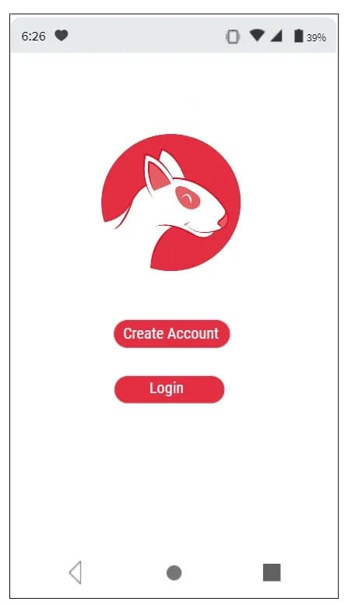
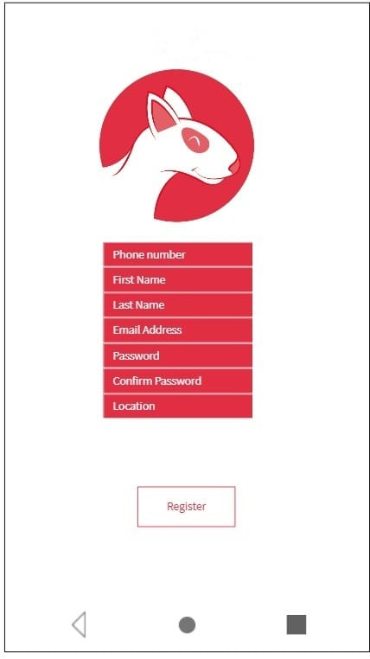

Slide 4
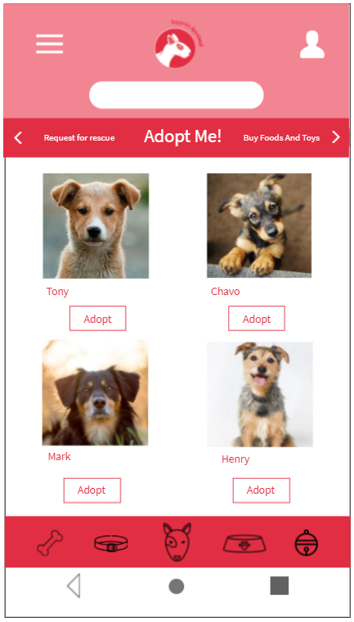
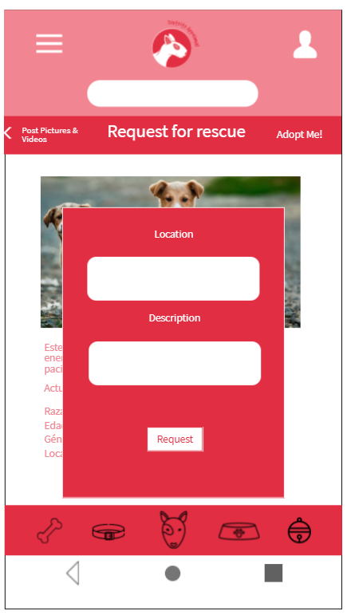
Adoption feature
Rescue request section

Slide 5
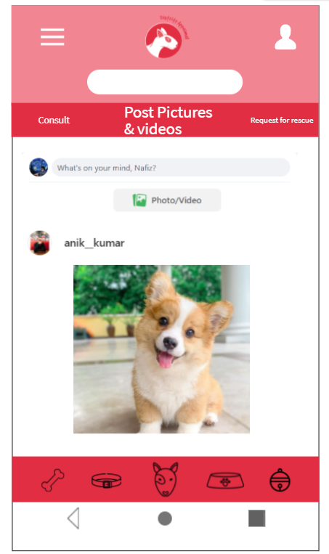
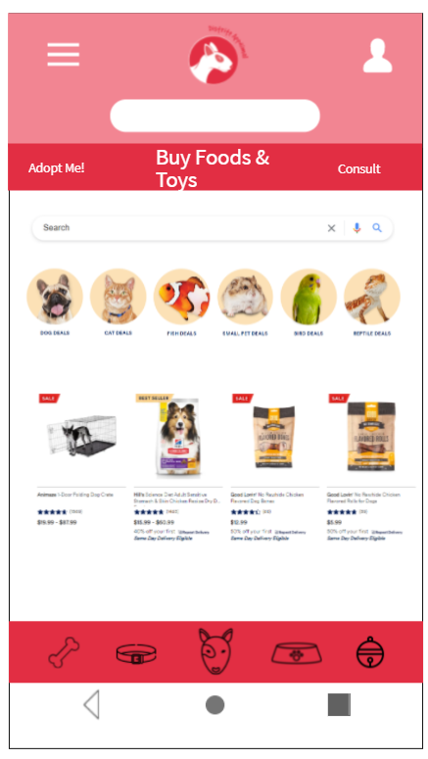
Newsfeed
Buying section

Slide 6
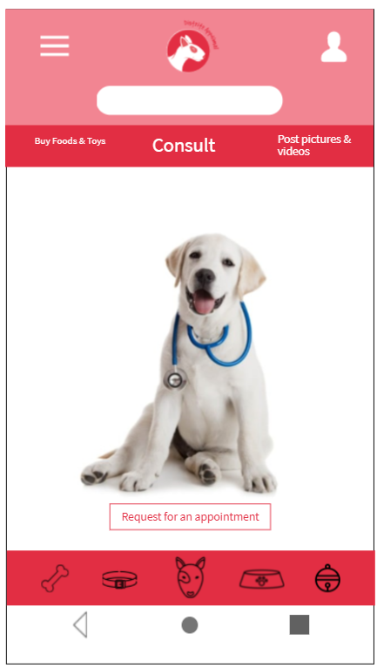
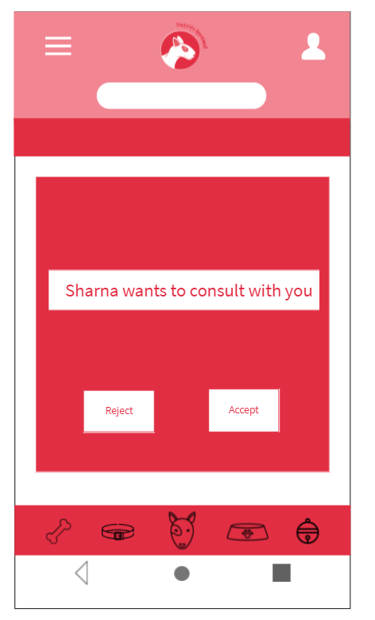
Consultation
Consultant

Slide 7
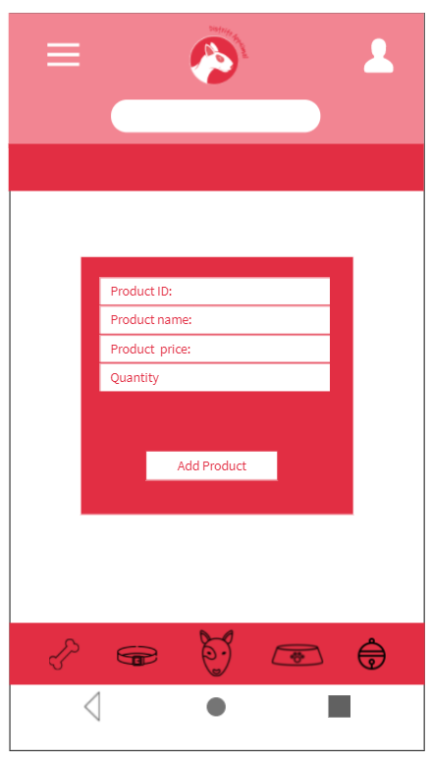
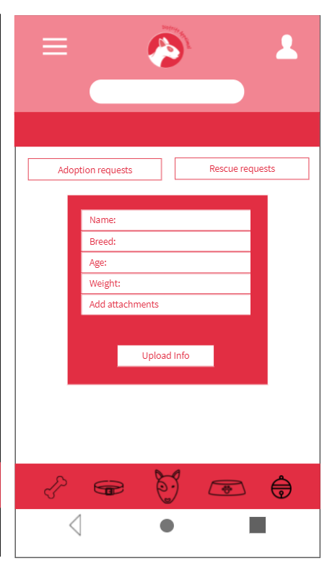
As a shop
As a recue center

Slide 8
Thank You

